Slide 1
BEST PLACES TO EAT PIZZA

Slide 2
POSSIBLE DESTINATIONS
San Francisco, CA
Boston, MA
Chicago, IL
New York, NY
Jersey City, NJ

Slide 3
MAPS OF THE AVAILABLE CITIES

Slide 4
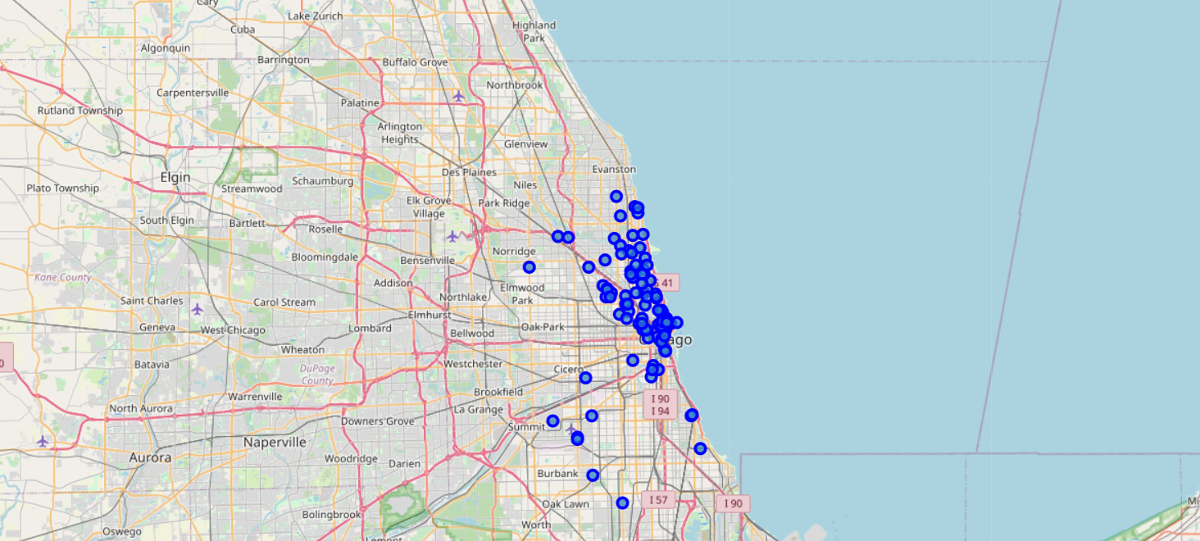
NEW YORK

Slide 5
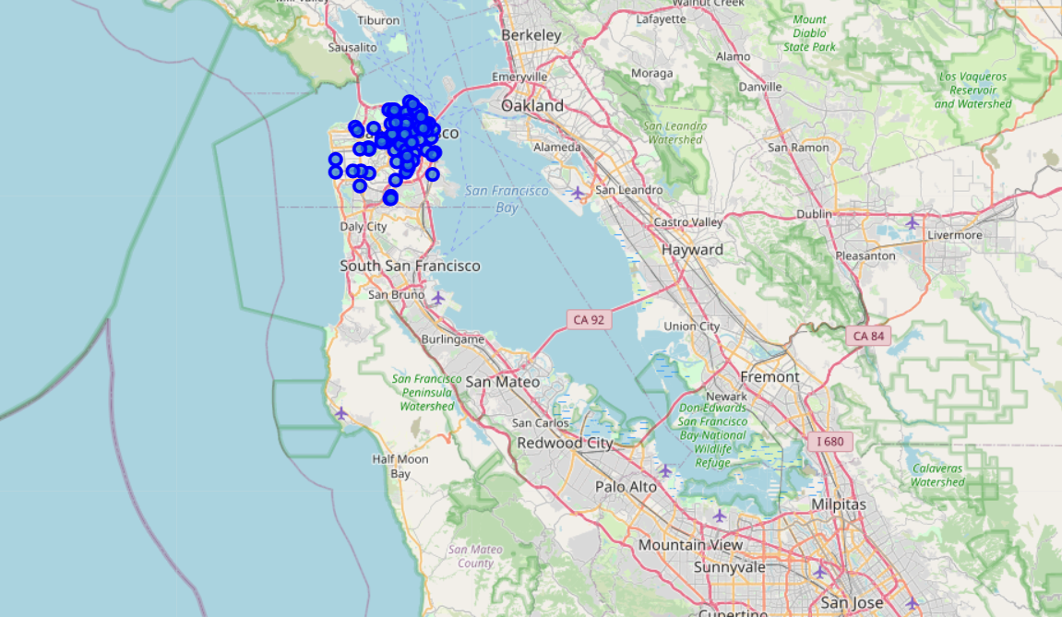
SAN FRANSCISCO

Slide 6
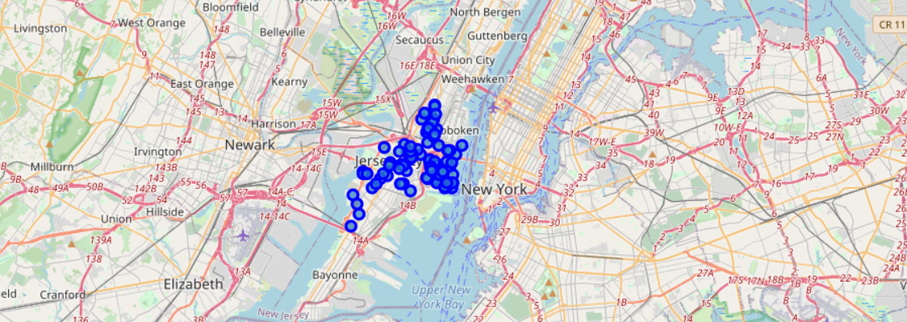
JERSEY CITY

Slide 7
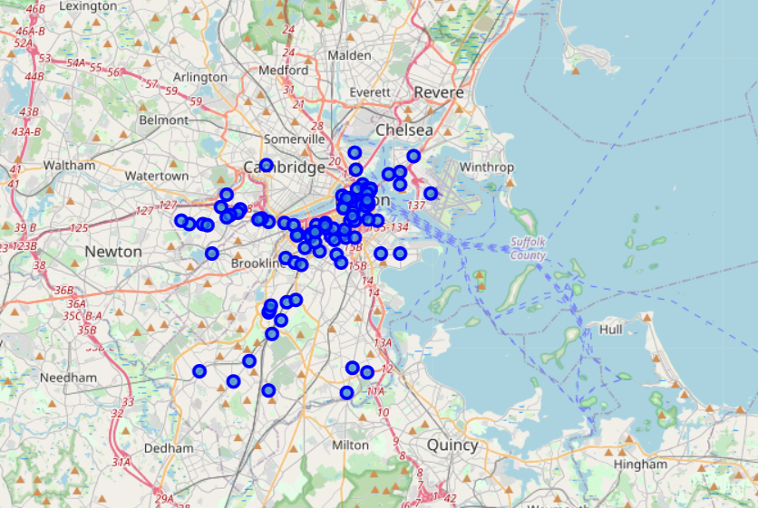
BOSTON

Slide 8
METHODOLOGY
Calculate center of all pizza places.
Calculate the distance of each pizza place from the center.
Ranking of cities according to the lowest distances.

Slide 9
Best Places to eat pizza
The following cities are ranked accordingly :-
New York
Jersey City
San Franscisco
Boston
Chicago

